Slide 1
Promotion of Adult Education on a Regional Level – Role of Regional Coordinators
Danijel Đekić, Hrvoje Jelen
Obrtničko učilište
3.10.2023.

Slide 2
Craft College
Association of Craftsman Zagreb
Chamber of Trades and Crafts Zagreb
Croatian Chamber of Trades and Crafts
Founded in 2006
20 employed >150 external experts
Tasks:
  linking vocational education with economy and regional development
  encouraging innovations in craft and VET
  establishing a network system with companies and other educational institutions
  taking an advisory role for education institutions and companies in the region
  continuous research of needs in crafts for appropriate personnel
  capacity building in VET

Slide 3
Craft College
Reskilling programs
Up-skilling programs
Programs of Vocational Specialization
Preparations for Master Craftsman Exams
Development of Educational Programs; Teaching and Training Methods; Digital competencies; Quality in VET and Adult Education
Erasmus Accreditation in Adult Education
Active applicant and partner in Erasmus+ KA1, KA2, KA3 projects, Interreg HR-IT
Capacity Building in VET
  MC.VET - Microcredentials - A New Path for Capacity Building in VET (2022)
  EmployVET - Engaging Employers for a Relevant and Resilient VET (2023)

Slide 4
About LL Week
The General Conference adopted a resolution in November 1999 to officially launch the International Adult Learners Week, embracing International Literacy Dayas its pivotal day and recognizing the amplified notion of learning throughout life
14 years
Lifelong learning week - designed as a campaign in which the message about the importance of education and learning is conveyed to citizens in an immediate, often informal way.
  a large number of very different activities are organized - from lectures, workshops, round tables to concerts, exhibitions, and even bicycle rides
  open days and other similar activities aimed at introducing the public to their work.

Slide 5
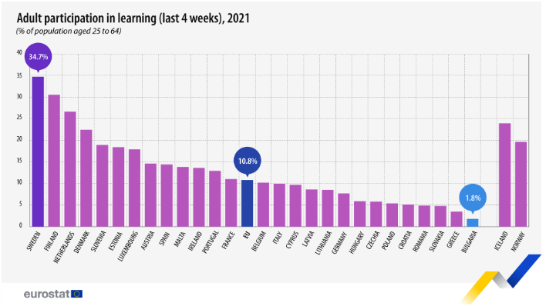
Lifelong learning in Croatia

Slide 6
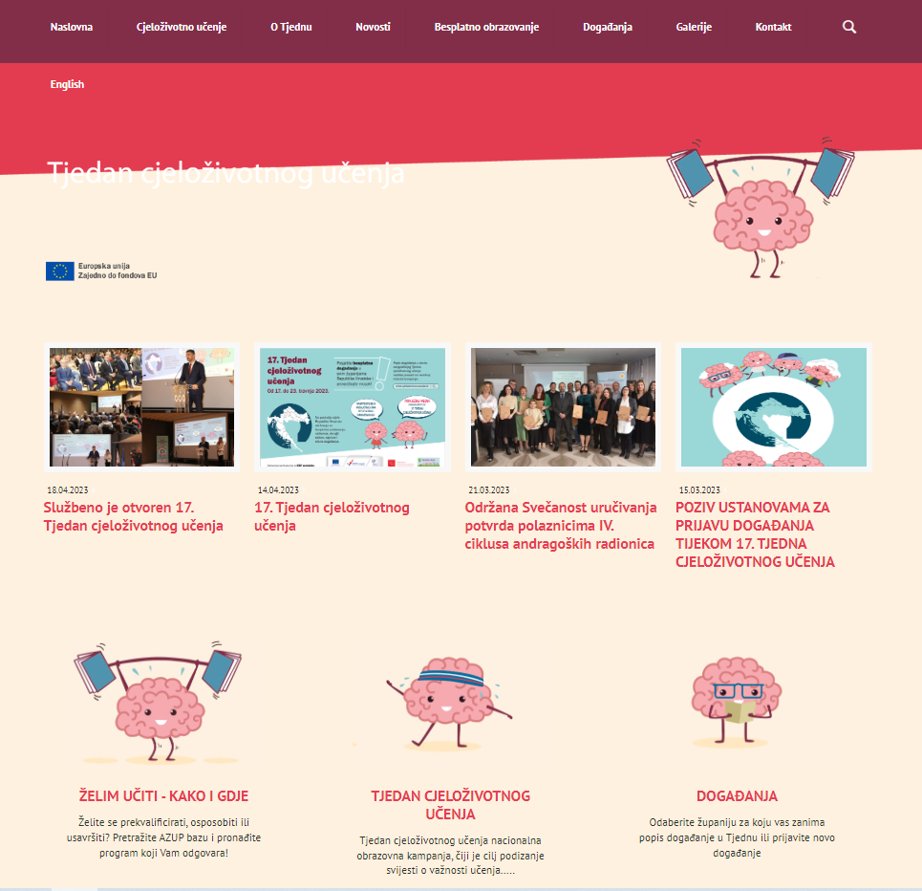
About LL Week
Until 2016 implemented by ASOO
  Lifelong Learning Fair
https://www.youtube.com/watch?v=XWkDd0DMdeU
https://www.cjelozivotno-ucenje.hr/

Slide 7
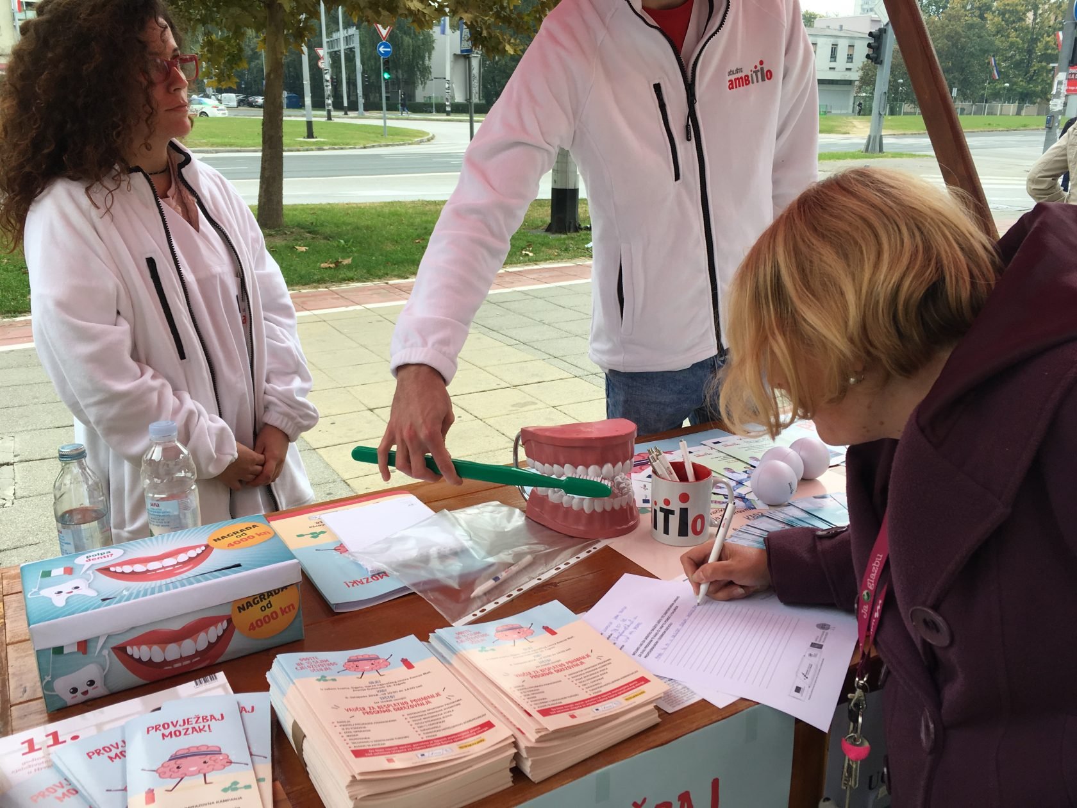
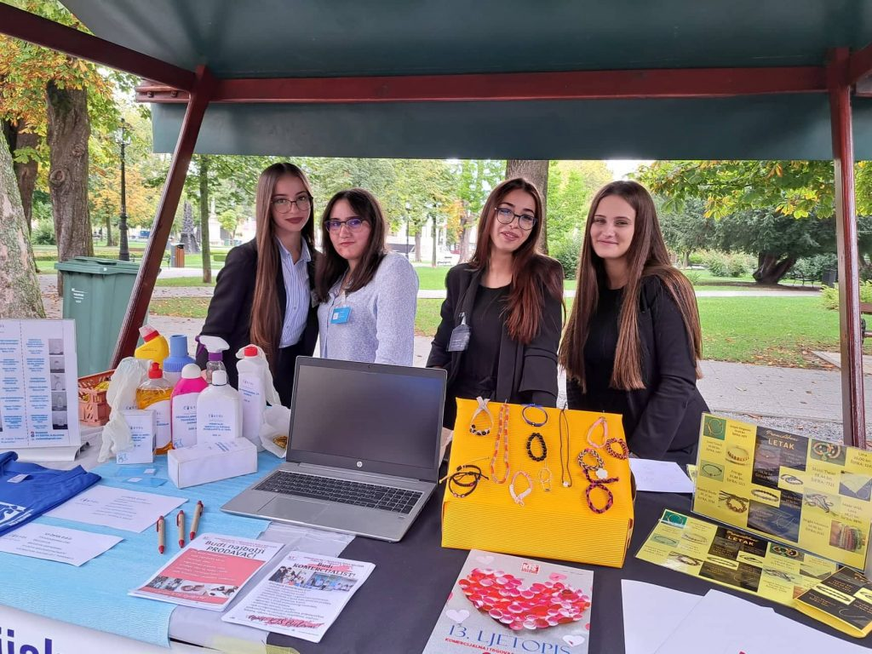
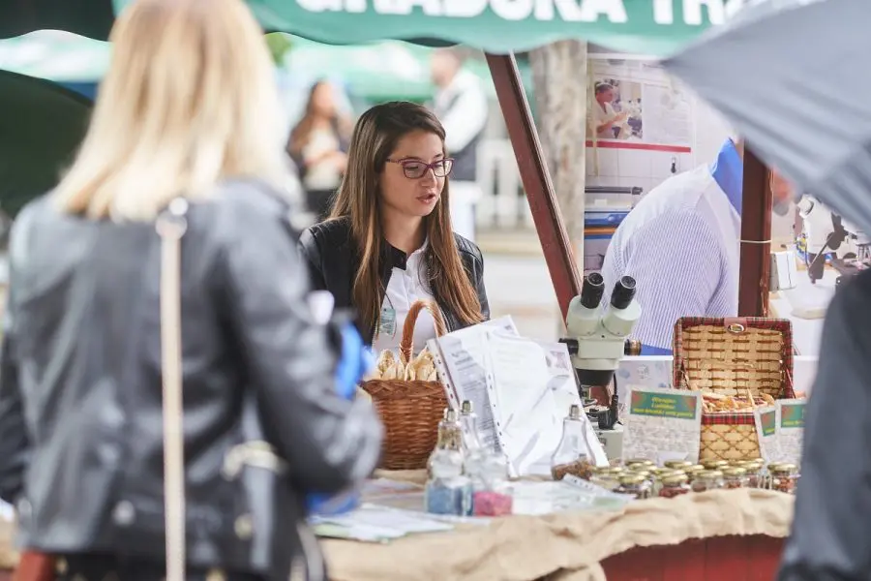
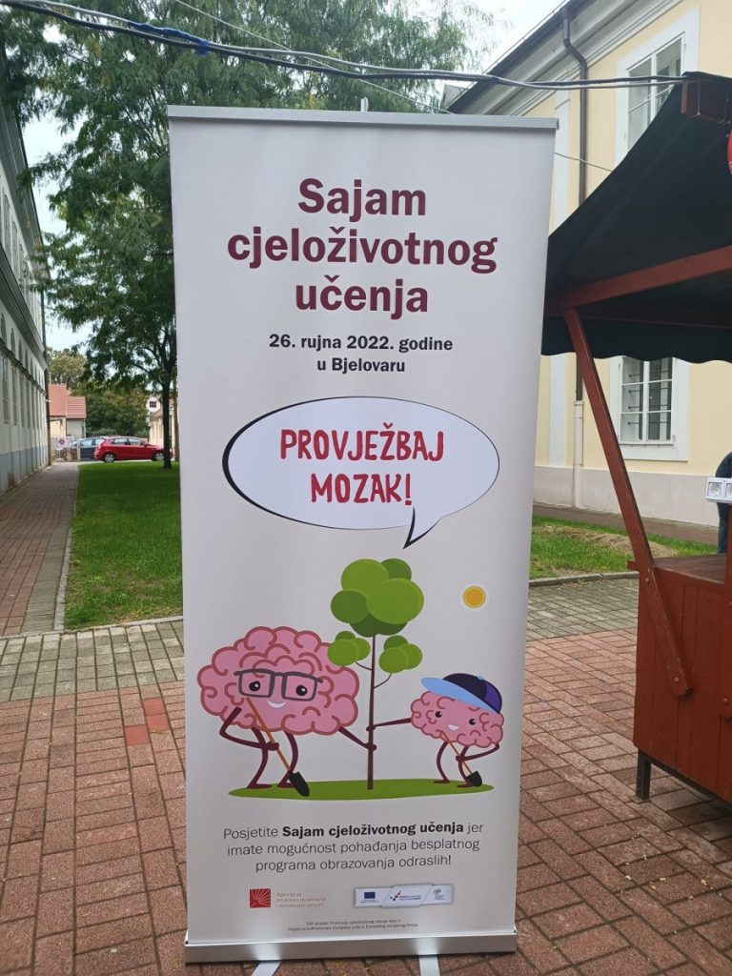
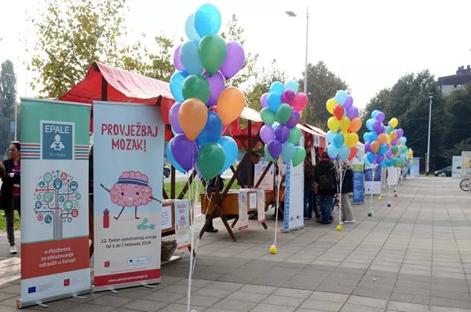
Lifelong Learning Fair

Slide 8
Regional Coordinator
Since 2016 introduction of Regional Coordinators
Adult education institutions and secondary vocational schools, which collaborate with the Agency on:
  designing and implementing activities within the Week,
  animating and motivating institutions at the local and regional level,
  informing citizens about learning opportunities in their communities.
In Croatia = 8 regional coordinators (1 coordinator for 2-3 counties)

Slide 9
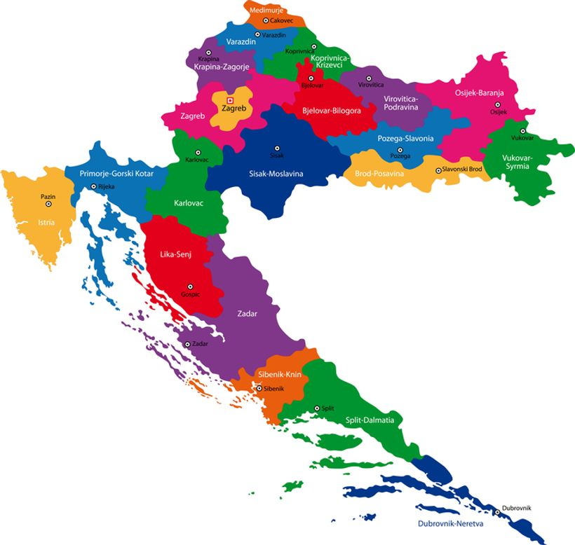
Craft College
Regional coordinator for City of Zagreb, Zagreb County, Karlovac County and Krapina-Zagorje County
2016 – 2018, 2021 – 2023

Slide 10

Roles
Providing information to organisations
  Meetings with organisations
  Mailing lists with more than 1000 recipients
  Information to general public
  >45 meetings with over 100 institutions
Distribution of promotional material
  Designed and purchased by ASOO
  Distribution to all providers of events – leaflets, posters, pencils, etc.
Participation in promotional activity
  Promoting LL Week in media

Slide 11
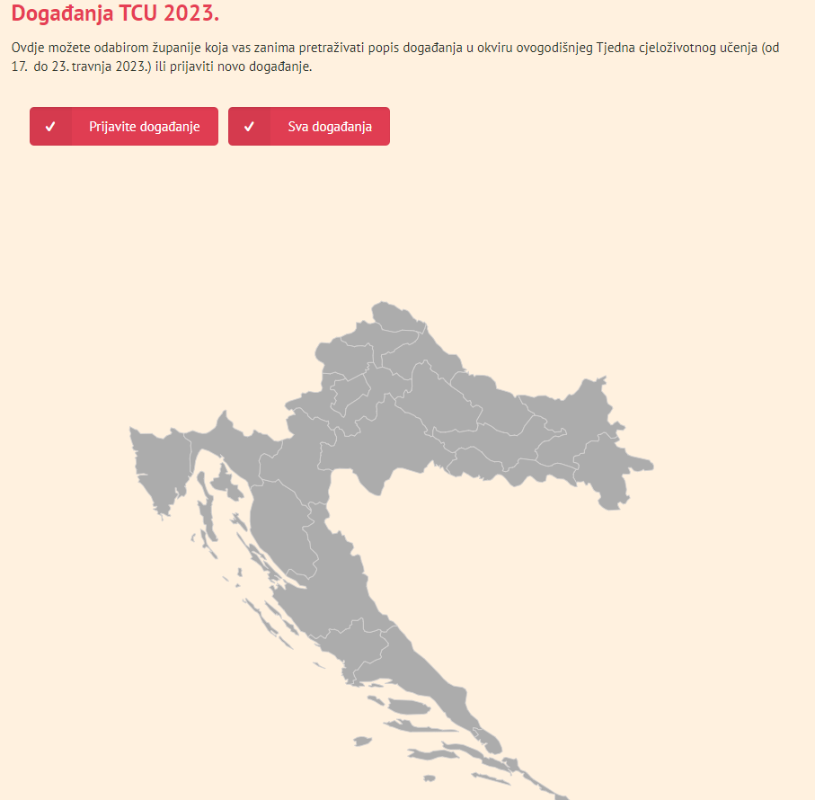
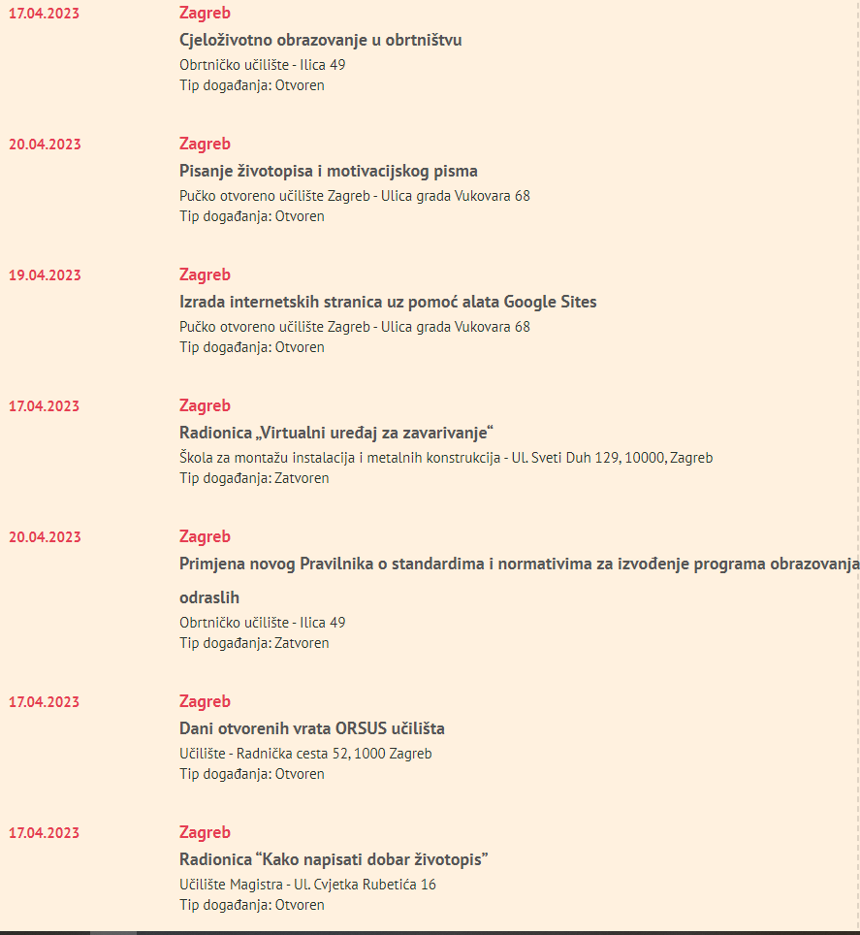
Lifelong learning webpage offers information on organized events by region

Slide 12
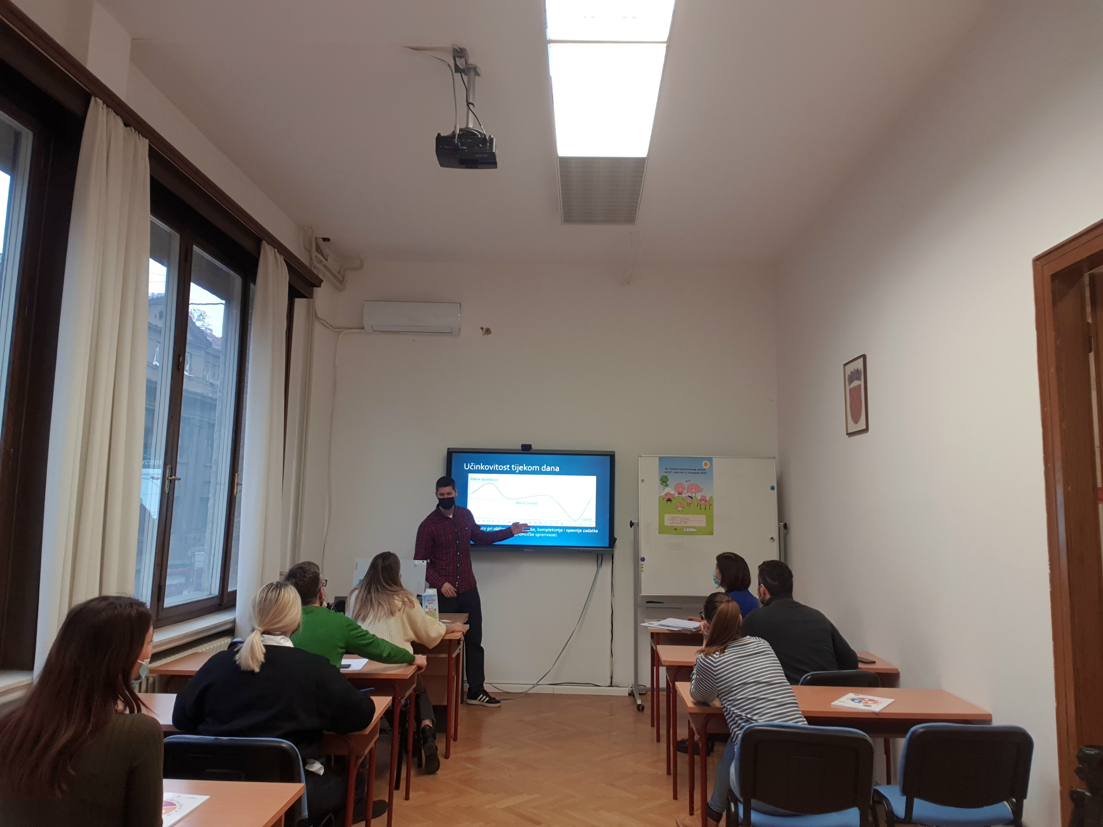
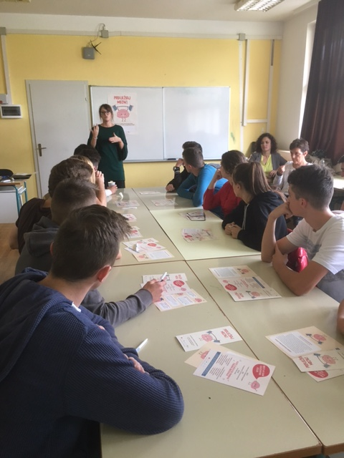
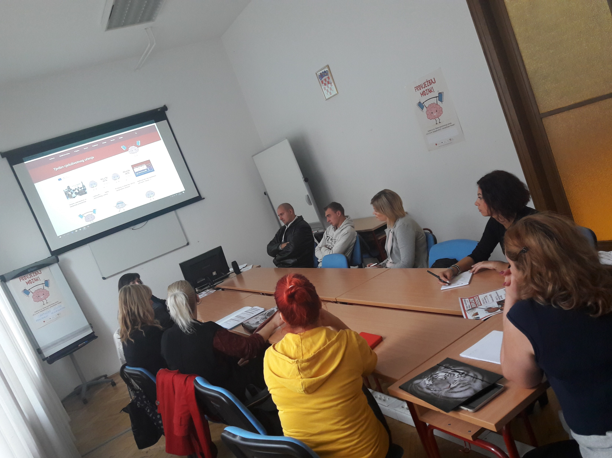
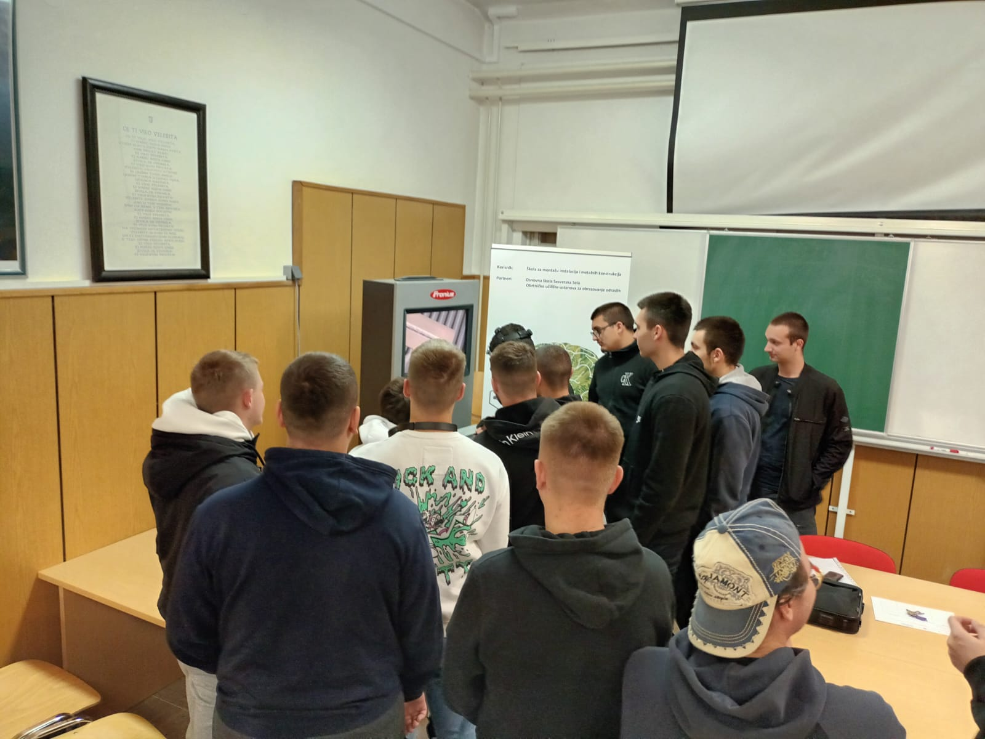
Roles
4. Organisation of events
Year | No. of events | No. of participants
2016 | 6 | 150
2017 | 18 | 227
2018 | 15 | 261
2019 | 4 | 41
2020 | 5 | 50
2021 | 15 | 204
2022 | 12 | 167
2023 | 12 | 156
Total | 87 | 1256

Slide 13
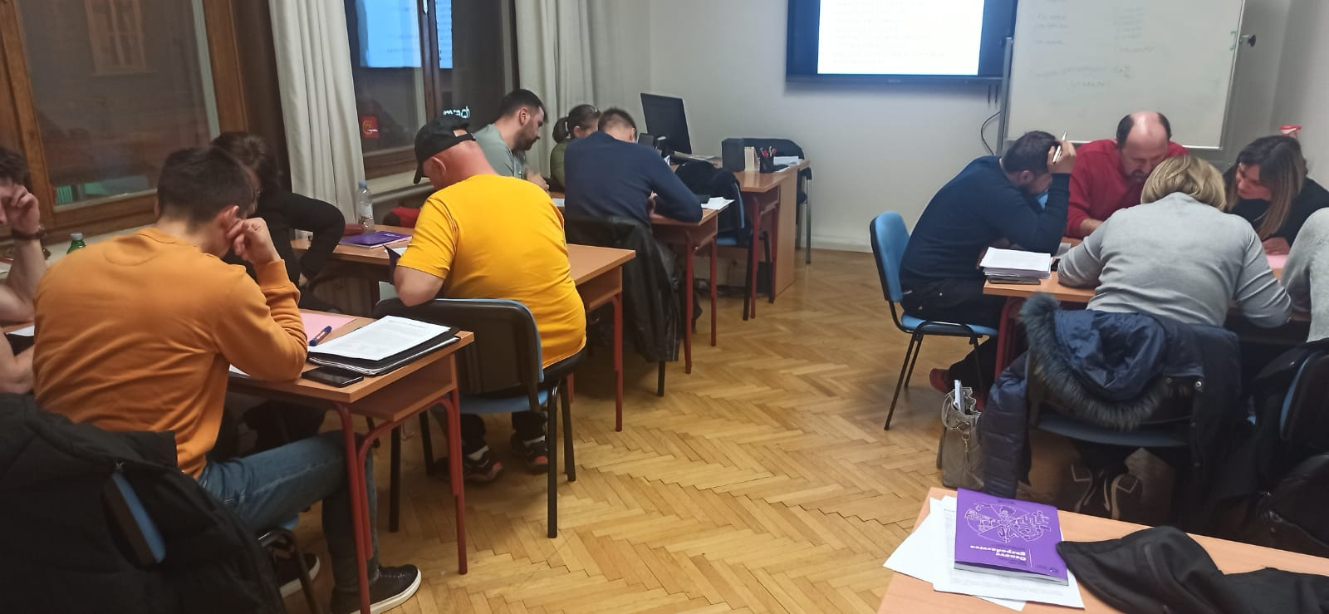
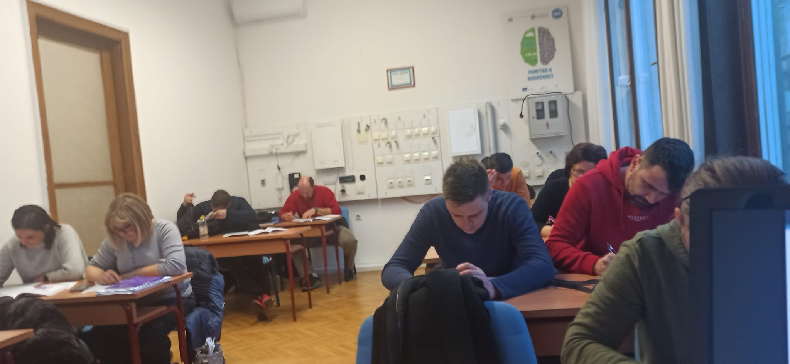
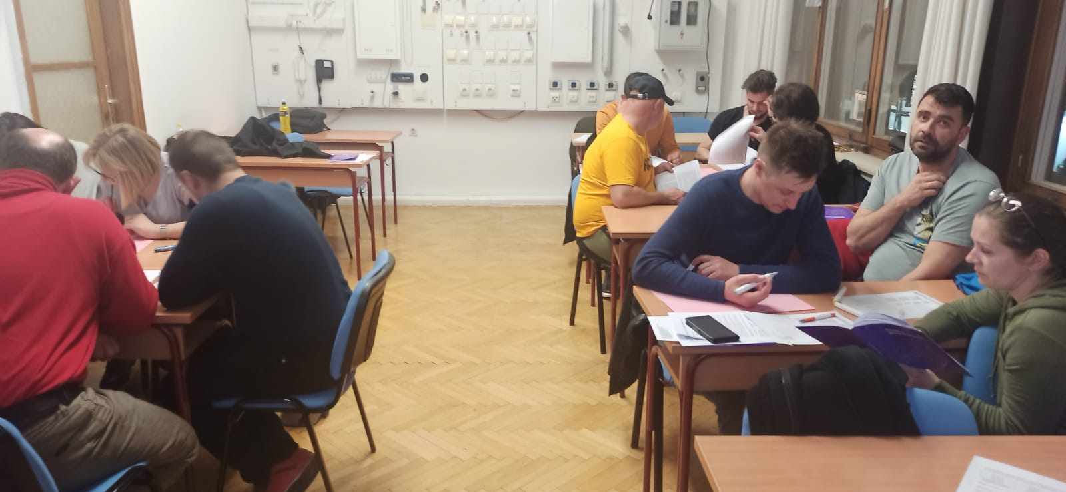
Promoting lifelong learning in craftsman vocations also drew aplicants for preparations course for the master craftsman exam

Slide 14
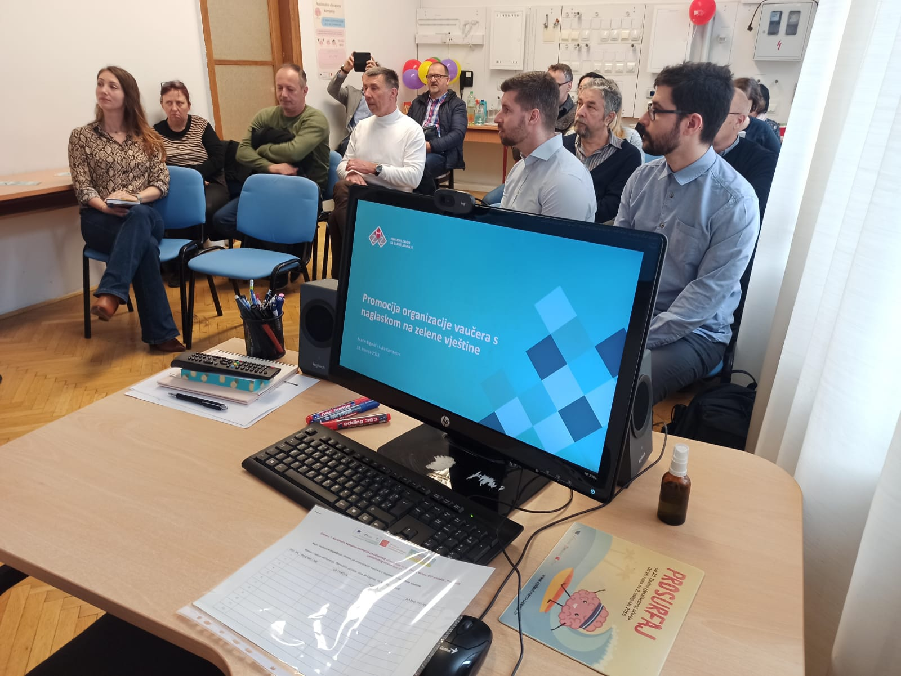
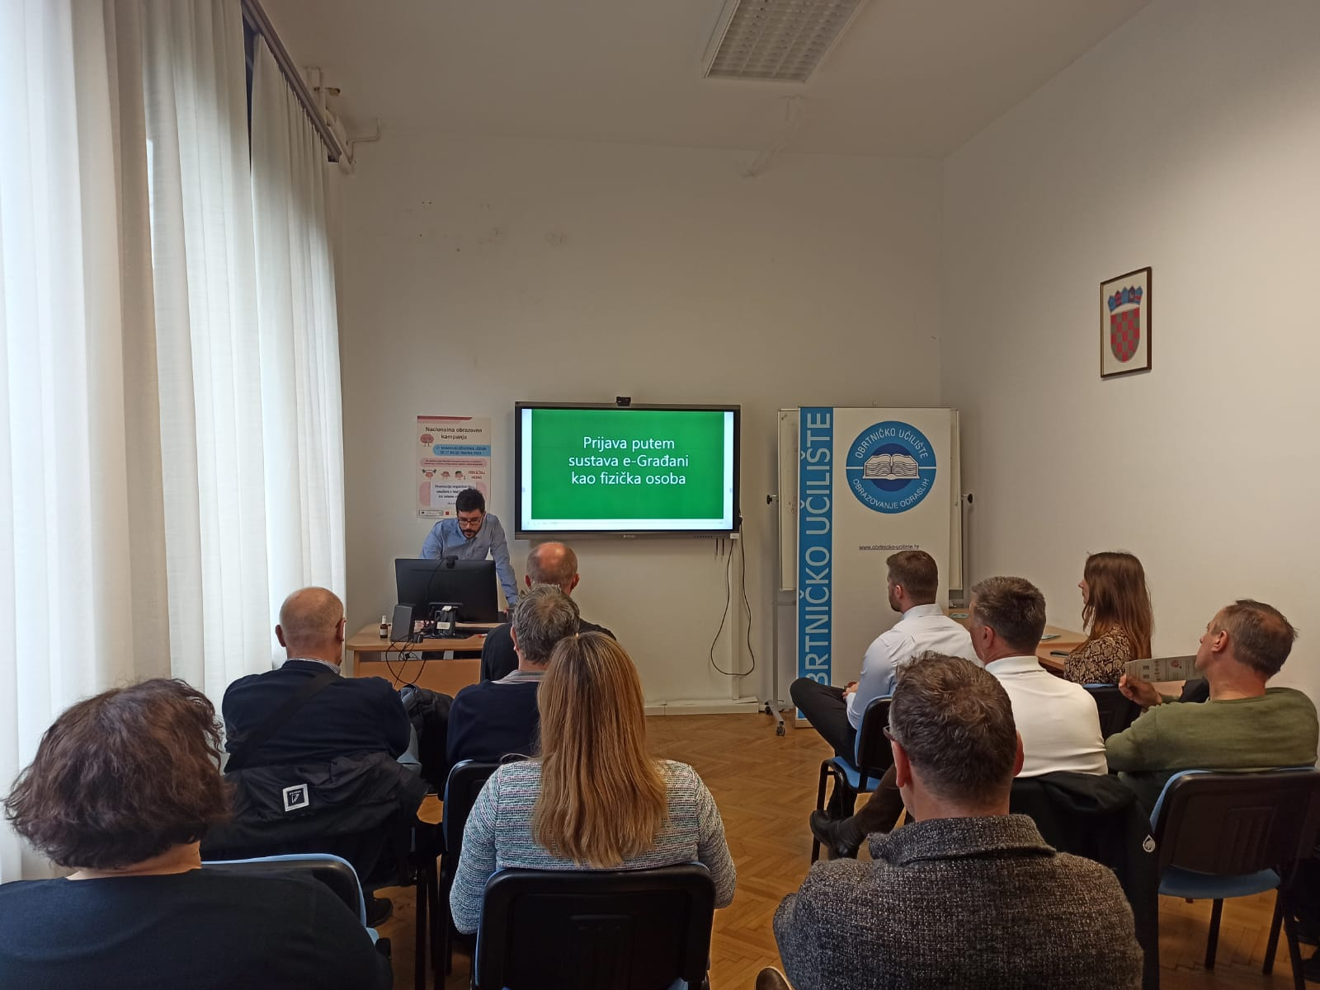
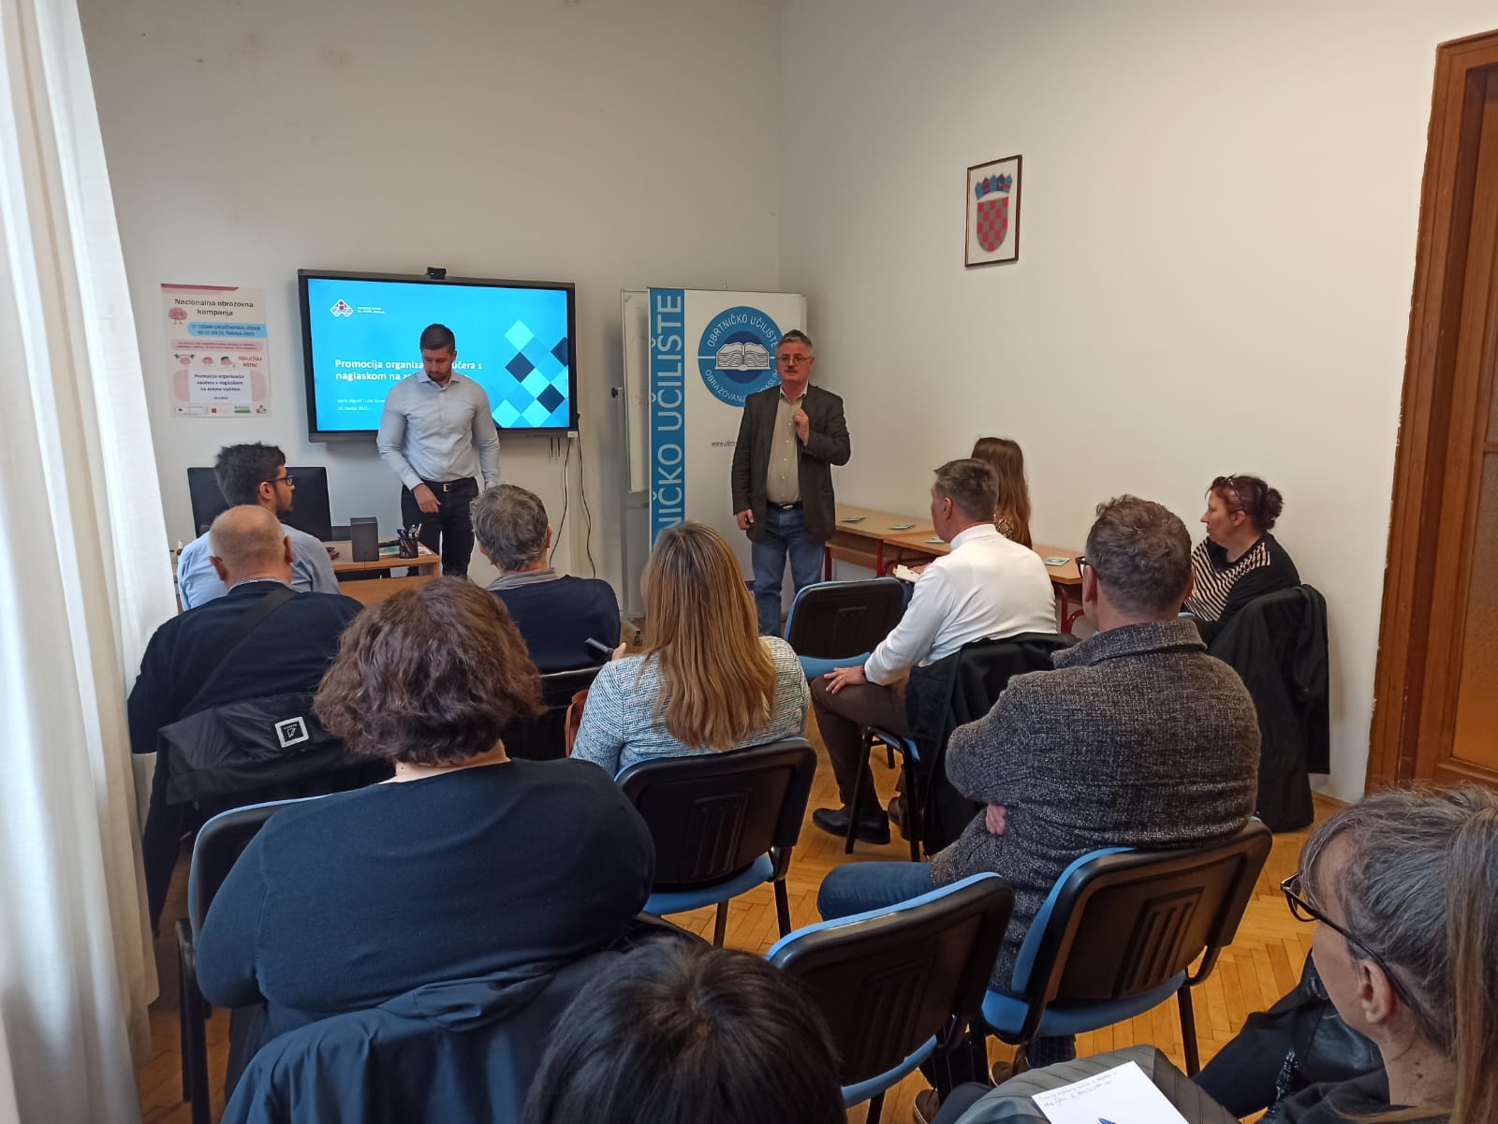
Promoting green skills in adult education with guest lecturers form Croatian Employment Service

Slide 15
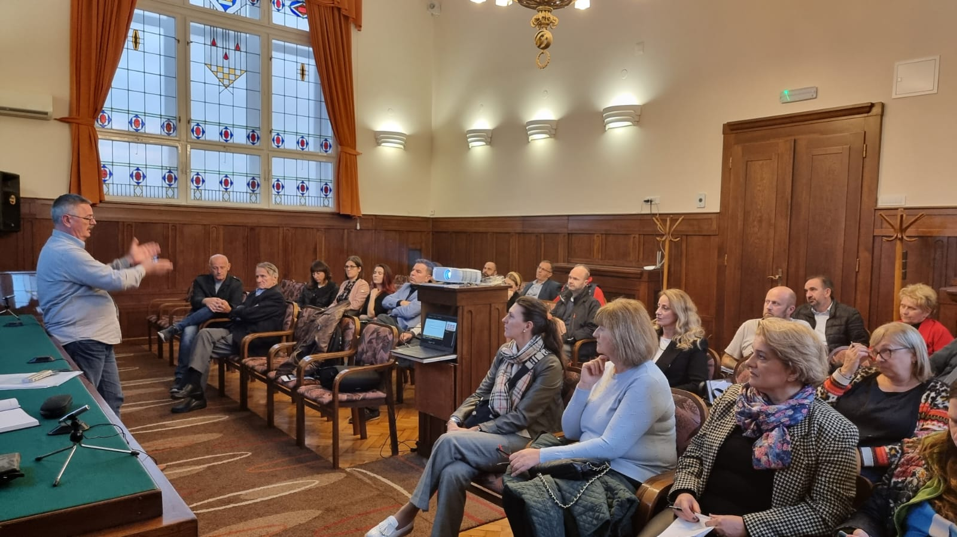
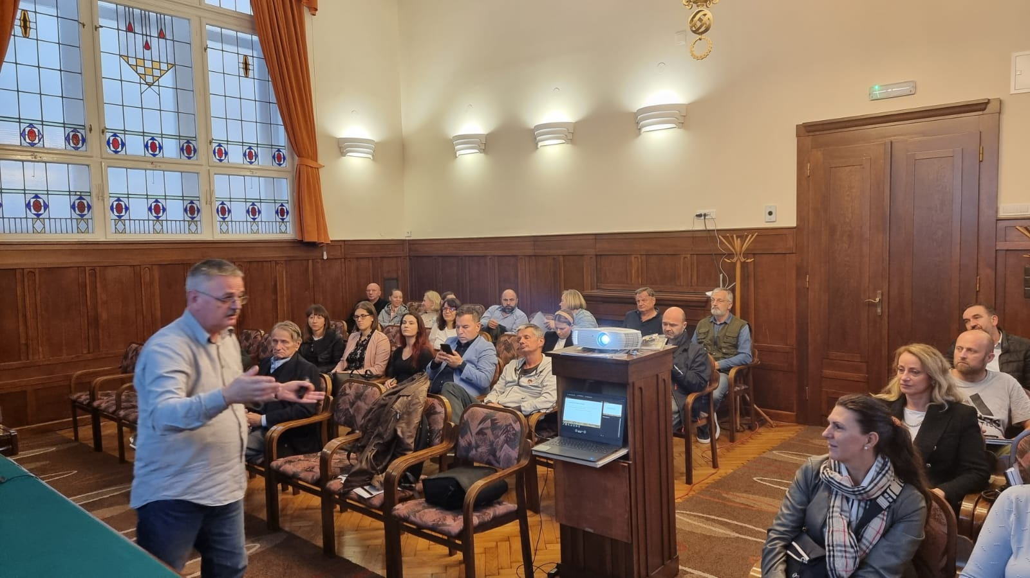
Lifelong learning promotion at the Association of Craftsmen Zagreb

Slide 16
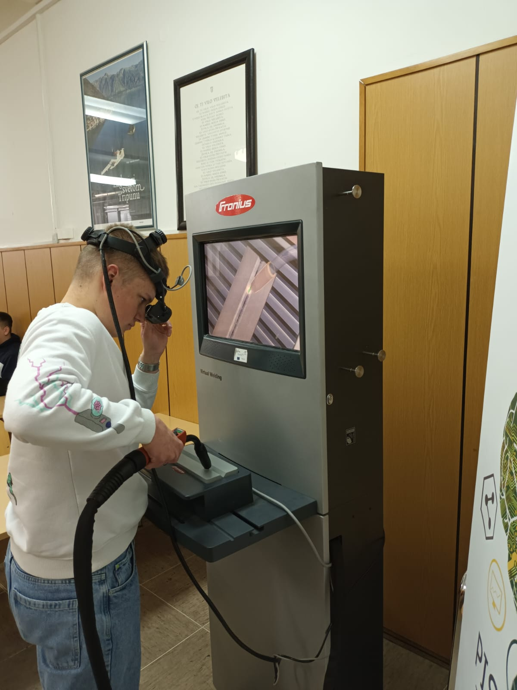
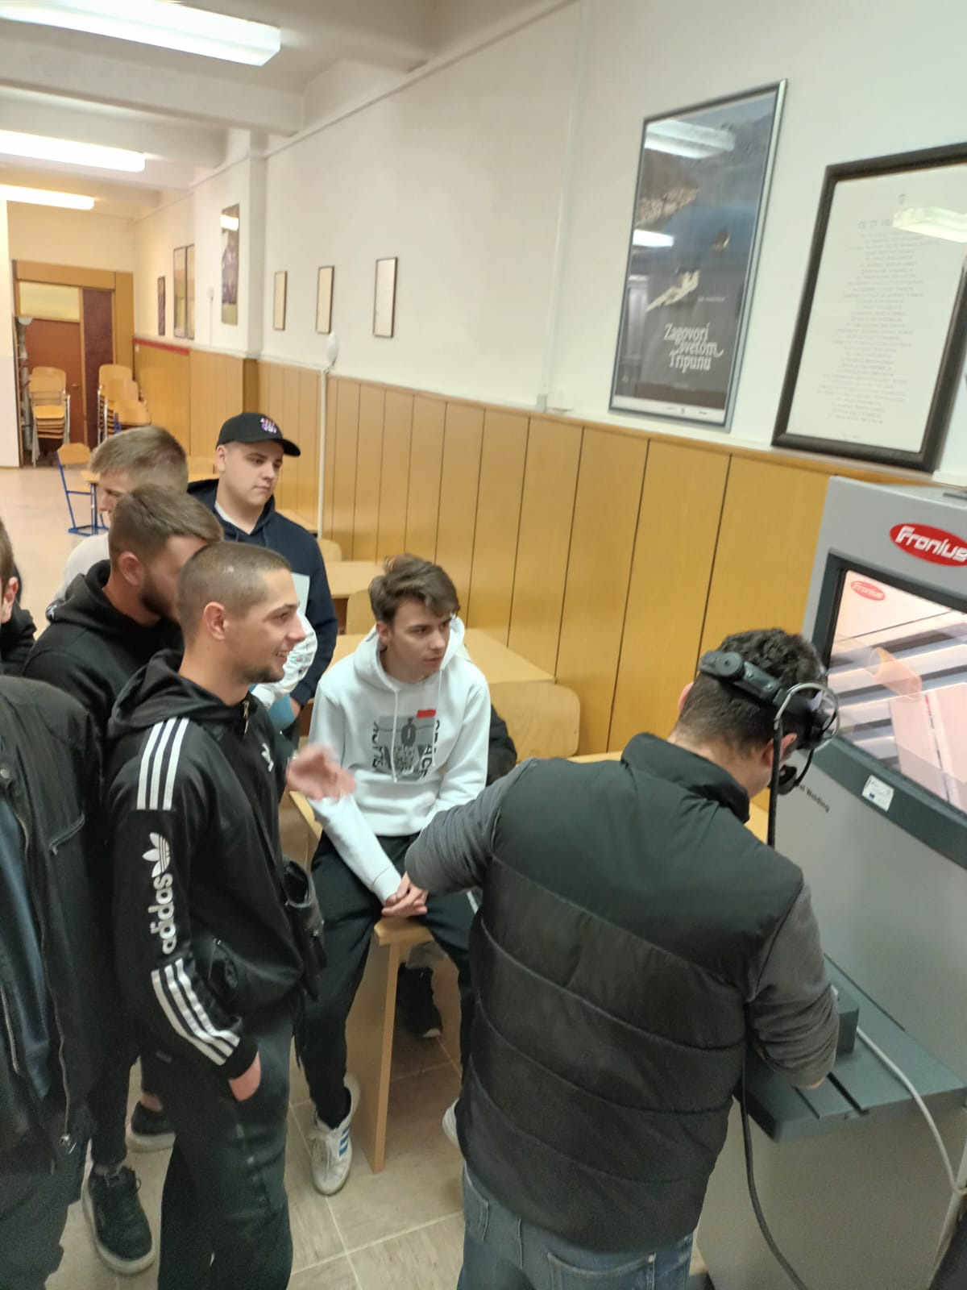
Promoting upskilling opportunuties to VET students – Virtual welding

Slide 17

Thank you for your attention!
Questions?

