Slide 1
POU Samobor - example of good practice of an adult education institution (promotion and implementation of activities)
Itana Bukovac, head of Adult Education department
Public Open University Samobor

Slide 2
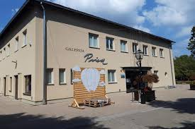
About us
A public non-profit institution founded by the Samobor City
Budget-funding
19 employees
Adult Education Department
Culture Department
Youth Center
Cinema
Prica Gallery

Slide 3

Adult education department
18 formal programs (digital marketing, caregiver, nanny…)
6 courses (preparations for the state matriculation exam, Foto sesion workshops, aromatherapy workshops…)
3 courses for children (dance school, multimedia workshops drama workshops)

Slide 4

Civic Tuesday
Public lectures every Tuesday
Strengthening public awareness:
Enhencing democtratic processes
Social cohesion and human rights
Ecological sustainabilty

Slide 5

Adult education - how it is organized
Our institution is budget - financed, but adult education programs are self-financed
An adequate number of participants is required for the group to be started
Project financed (4 IPA, 4 ESF, 2 Erasmus+)
Vauchers for education (4 groups ongoing)

Slide 6

How to serve the public education needs
Samobor: 50,000 inhabitants
All residents are our users
How to meet the education needs of 50,000 users
Focus groups organized with stakeholders
Training need analysis

Slide 7

Our role in the community
Helping people to get competencies to adapt to a changing world
Designing new programs that enable participants to achieve their goals
Networking with stakeholders at the local level also support our participants achieve their goals

Slide 8
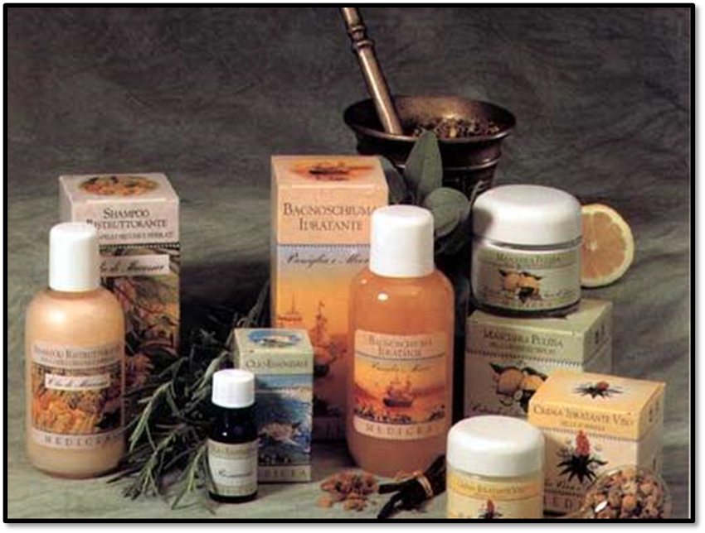
Designing program in cooperation with association
The association needs a program Planting and processing of medicinal plants
Ecological production
Creation of a new brand on market
EU market orientation
The program has launched many other programs for adult and aspiring farmers

Slide 9

Designing program in EU project
Adult education program for Nannies
Create in EU project 2011
Aimed for unemployed women
The program caused a lot of discussion
Result: Nanny Low
It is still active today

Slide 10

Designing program in EU project 2
Event Manager
Intended for young people with good ideas who have left their studies
Training needs analysis
Education program as a tool for starting their business

Slide 11

Designing program in cooperation with employer
Service for heat pumps in Samobor
Need for an educated workforce
Joint collaboration - formal program serviseing heat pumps
Ongoing enrolling participants in designed program

Slide 12

How we communicate with the public
Web
Facebook
Mailchimp mailing list
Posters & Jumbo Posters
Radio show & local newspapers
POUS Monthly program – Newsletter

Slide 13

WEBSITE
Information of all programs
Callendar of all events
News
Special search engines – linkage to participants

Slide 14

Facebook
3,600 followers
Boosting posts – enhanceing our visibility on social media
Facebook Giveaways – idea to get more followers and likes
We invite influencers to talk about us

Slide 15

Mailchimp mailing list
Collecting e-mail addresses for 10 years
Regular sending of notifications about events
Sorting contacts by interest
Over 1,000 contacts

Slide 16

Posters & Jumbo Posters
Small posters we create ourselves
Jumbo posters are designed by professionals
Every Tuesday we put up posters in all important places in Samobor and the surrounding area
Once a month we present a Jumbo poster with the most important events

Slide 17
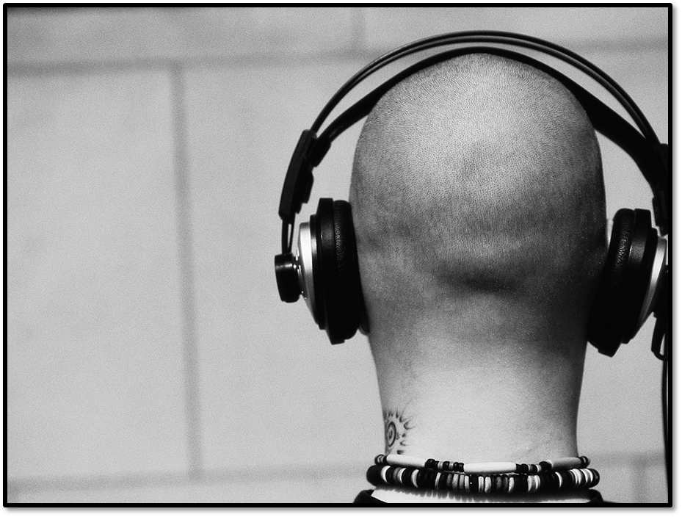
Radio show & local newspapers
Every week we are present in announcements on local radio
Local media have their web and Facebook pages where our news is repeated
Local printed editions are rare, but we try to participate in that form of informing as well

Slide 18

POUS Monthly program – Newsletter
At the beginning of each month, we send a newsletter - Monthly program of events
E-mail addresses have been collected for 10 years

Slide 19

Look at the bigger picture
Artificial Intelligence is taking all work places
Working places for people are disappearing

Slide 20

Adult education is solution to a problem
Creating new jobs through new ideas
Creating new way of making money for living
Adult education can be tool for achieving that goal
Notes:
These people need education as a tool to achieve their goals

Slide 21
Thank you for attention
☺

