Slide 1

VET AND CVET UNDER THE JURISDICTION OF THE CHAMBER OF CRAFTS
ZAGREB CHAMBER OF TRADES AND CRAFTS

Slide 2

ZAGREB Chamber of Trades and Crafts
  Zagreb Chamber of Trades and Crafts is the largest chamber of Trades and Crafts in the Republic of Croatia and covers areas of the City of Zagreb and Zagreb County
  Chamber is association of tradesmen and craftsmen established to promote trades and crafts and represents the interests of tradesmen and craftsmen
  Offers various services in order to help tradesmen and craftsmen in their everyday business practice
  Croatian Chamber of Trades and Crafts has a public authorities in the field of initial and lifelong vocational education and training for crafts

Slide 3
VET AND CVET UNDER THE JURISDICTION OF THE CHAMBER OF CRAFTS
In the area of initial vocational education, Croatian Chamber has public authorities in issuing licence for crafts and companies for apprenticeship training, in verifying apprenticeship contracts and participating in apprenticeship exams
In the area of continuing vocational education, Chamber organizes and conducts Master craftsman exams, Vocational competences exams and Exams in elementary teaching skills for teaching apprentice in licensed workshops
Notes:
Public authorities in the area of the vocational education for associated trades and crafts:
initial high-school education:
conducting trades, crafts and legal entities licensing for practical and apprenticeship training, verifying apprenticeship contracts, participating in apprenticeship exams
the area of continuing education for trades and crafts:
conducting master craftsman exams, vocational competences exams and other forms of lifelong learning in the area of trades and crafts
other activities connected to the cooperation with the relevant public authorities, institutions and associations in country and abroad in order to exchange mutual experiences and further enhance vocational education

Slide 4
VET AND CVET UNDER THE JURISDICTION OF THE CHAMBER OF CRAFTS
Issuing licences for apprenticeship training
Master Craftsman Exam
Vocational competences exam
Exam of the basic knowledge needed for teaching apprentice

Slide 5
VET AND CVET UNDER THE JURISDICTION OF THE CHAMBER OF CRAFTS-legal framework
  VET for crafts professions is regulated by the Law on Trades and Crafts and its by-lows:
  By-law on master craftsman’s exam and vocational competences exam
  Programmes of master craftsman exams
  Programmes of vocational competences exams
  Programmes of exams of elementary teaching skills for teaching apprentice
Notes:
Public authorities in the area of the vocational education for associated trades and crafts:
initial high-school education:
conducting trades, crafts and legal entities licensing for practical and apprenticeship training, verifying apprenticeship contracts, participating in apprenticeship exams
the area of continuing education for trades and crafts:
conducting master craftsman exams, vocational competences exams and other forms of lifelong learning in the area of trades and crafts
other activities connected to the cooperation with the relevant public authorities, institutions and associations in country and abroad in order to exchange mutual experiences and further enhance vocational education

Slide 6
IVET UNDER THE JURISDICTION OF THE CHAMBER OF CRAFTS
Chamber is one of the stakeholders in Unified model of education for craft professions (JMO)
JMO is under the jurisdiction of Ministry of science and education, Ministry of economy and crafts, and Chamber of trades and crafts
JMO combines school based learning with the on-the-job training
Theorethical education in vocational schools and apprenticeship in licenced crafts or legal entitities
Notes:
Public authorities in the area of the vocational education for associated trades and crafts:
initial high-school education:
conducting trades, crafts and legal entities licensing for practical and apprenticeship training, verifying apprenticeship contracts, participating in apprenticeship exams
the area of continuing education for trades and crafts:
conducting master craftsman exams, vocational competences exams and other forms of lifelong learning in the area of trades and crafts
other activities connected to the cooperation with the relevant public authorities, institutions and associations in country and abroad in order to exchange mutual experiences and further enhance vocational education

Slide 7

LicenCing
To carry out the practical part of apprenticeship craftsman or company are required to have the licence for apprenticeship
The licencing procedure is carried out by the regional Chambers of trades and crafts
MATERIAL CONDITIONS - appropriate space and workplace for the student, appropriate equipment, and safety measures at work
STAFF CONDITIONS – mentors with appropriate vocational education and proof of teaching skills (Exams of the basic knowledge needed for teaching apprentice)

Slide 8
LicenCing
Acording to the the Law on Trades and Crafts mentors can be:
Master craftsmen with master craftsmen exam
Persons with appropriate vocational education and at least 7 years of work experience in the profession and proof of teaching skills
Persons with appropriate higher education and proof of teaching skills

Slide 9
Exams of the basic knowledge needed for teaching apprentice
For the persons who, in accordance with the Act on Trades and Crafts, meet the conditions to become
mentors, but have not passed the master's exam, in order to obtain a licence for the apprenticeships
The exam on the basic knowledge required for teaching apprentice consists of writing exame and practical exam
The practical part of the exam includes written preparation and performance of practical teaching
apprentice
Exam sessions 4 times a year

Slide 10
Master Craftsman Exam
State approved exam
Level 5 of the EQF
62 vocations from the list of associated trades and crafts
Exam sessions 2 times a year
Requirement for opening or running a business in certain crafts and enables the performance of apprenticeship exercises in craft

Slide 11
Master Craftsman exams -CONDITION FOR RUNNING craft
Toolmaker
Car Electrician
Car Mechanic
Car Mehatronic
Locksmith
Chimney Sweeper
Electrician
Electro-mechanic
Electronics Mechanic
Hairdresser
Ship and boat Builder
Dry cleaner
Stonemason
Boilermaker
Men’s tailor
Ladies’ tailor
Furrier
Cook
Butcher
Headwaiter
Optician
Shoemaker
Orthopaedic shoemaker
Pedicurist
Gas mechanic
Precision machinist
Gunsmith
Pastry chef
Glazier
Joiner
Machine fitter
Carpenter
Salesman
Plumber, air conditioning and heating mechanic
Mason
Goldsmith

Slide 12
IN ORDER TO ACQUIRE higher
QUALIFICATIONS
AND TO GET LICENCE FOR APPRENTICESS
Car painter
Panel beater
Boat mechanic
Façade fitter
Photographer
Leather craftsman
Musical instruments builder
Organ builder
Hatter
Blacksmith
Beautician
Roofer
Air conditioning and heating mechanic
Tinsmith
Founder
Mechanic for agricultural machinery
Miller
Dairyman
Stove fitter
Baker
Sign painter
House and woodwork painter
Upholsterer
Turner
Clock and watch maker
Plumber
Notes:
Further education in trades and crafts professions – LLL, continuing education

Slide 13
Master Craftsman Exam
Application requirements:
Appropriate vocational high school education and apprenticeship exam and two years of work experience in the profession for which they wish to take master craftsman exam
At least four years of work experience in the profession for which they wish to take master craftsman exam if they don´t have the required vocational high school education

Slide 14
Master Craftsman Exam
Structure
practical assignment and/or working exercise
testing professional and theoretical knowledge
testing knowledge in the field of economy and legal regulations
testing basic knowledge required for teaching apprentices

Slide 15
Master Craftsman Exam
Enables:
Run their own business
Higher positions at a company
Licence for aprenticeship
Most popular: Hairdresser, Beautician, Pedicurist, Electrician, Gas mechanics, Plumbers, Air conditioning and heating mechanics, Car mechanics and Car mechatronics.

Slide 16
Vocational competences exam
Level 2 EQF
22 vocations from the list of associated trades and crafts
Enables running own business in the craft profession for which exam is taken
Application requirements:
Minimally elementary school education
It is not necessary to have work experience in the jobs of a certain occupation
Recognition of informal and non-formal acquired knowledge and skills wich leads to public certificate

Slide 17
Vocational competences exam - occupations
Bender
Tool grinder
Floral designer
Woodworker
Woodturner
Arc welder
Construction glazier
Engraver/type cutter
Insulation worker
Ceramist
Massage therapist
Bicycle mechanic
Parquet layer
Floor layer
Grilled meat cook
Food and drinks server
Pie and pizza maker
Simple dishes and pastry cook
Mushroom picker
Deck layer
Tire repairman
Gas welder
Notes:
22 occupations

Slide 18
Vocational competences exam
Structure :
Practical assignment and/or work exercise
Testing knowledge necessary for independent running of trade or craft business
Exam sessions 5 times a year

Slide 19

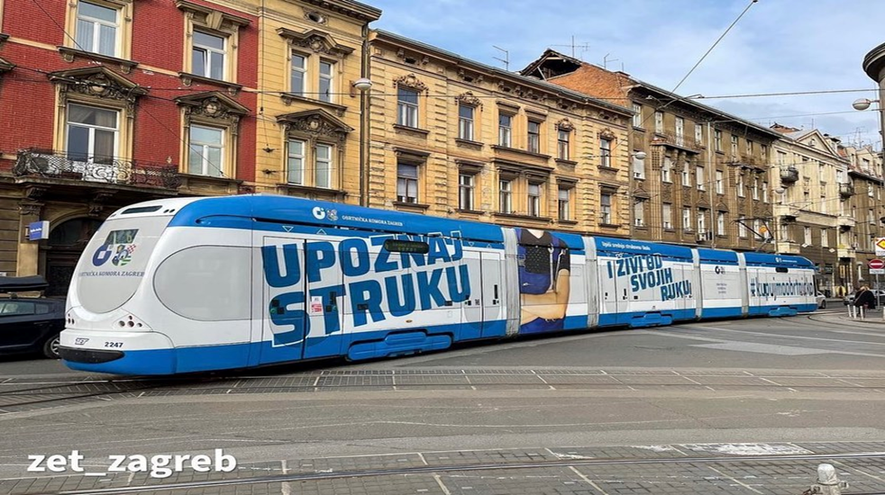
PROMOTION OF VET AND CVET UNDER THE JURISDICTION OF THE CHAMBER OF CRAFTS
Fairs, job fairs, school presentations
Billboards
Advertisements and promotional videos
ZAGREB CRAFTS FAIR
The fair gathers students of vocational high schools and craftsmen from the area of ​​the City of Zagreb and Zagreb County , where they present craft professions to visitors and students of seventh and eighth grades of elementary schools.

Slide 20
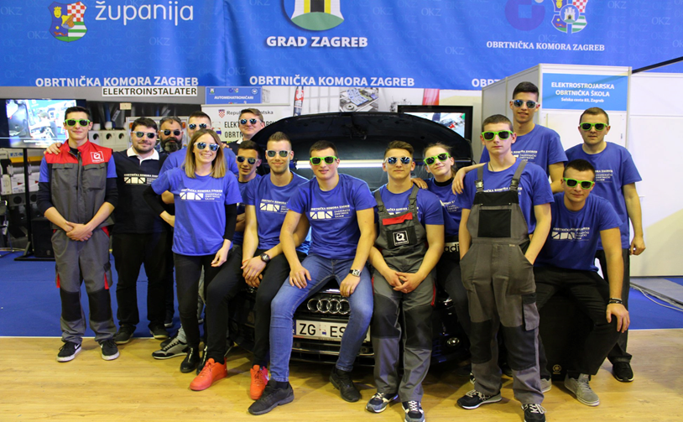
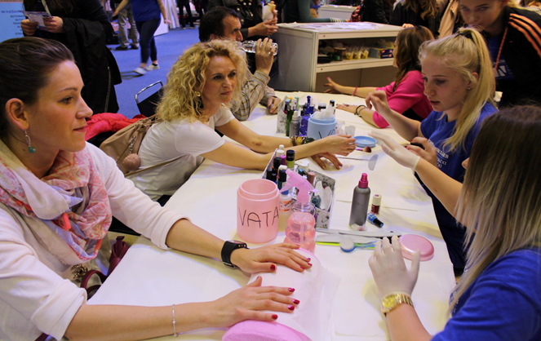
PROMOTION OF VET AND CVET UNDER THE JURISDICTION OF THE CHAMBER OF CRAFTS-ZAGREB CRAFTS FAIR

Slide 21
ZAGREB Chamber of Trades and Crafts
Thank you for your attention!
Zagreb Chamber of Trades and Crafts
Ilica 49/II, 10 000 Zagreb, Croatia
Tel: 01/4806 545
e-mail: okz@okz.hr, iva-tusin@okz.hr
web: www.okz.hr

