Slide 1
Adult education system in Croatia
Dr. Ivana Krešić Klaucke
Head of Department for Adult Education
October 2nd 2023.

Slide 2
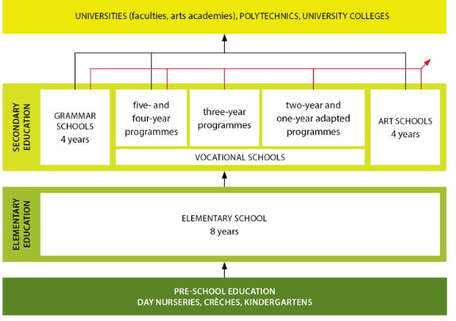
Education system in Croatia
Entry to the labour market
Entry to the labour market
Entry to the labour market
ADULT EDUCATION
(formal, non-formal and informal)

Slide 3
Governance
The Croatian education system is centrally managed by the Ministry of Science and Education.
Besides the Ministry, other national public bodies involved in the regulation, development and quality control of the educational sector in Croatia are
Education and Teacher Training Agency (ETTA),
Agency for Vocational Education and Training and Adult Education (AVETAE),
Agency for Mobility and EU Programmes (AMPEU),
National Center for External Evaluation of Education (NCEEE)
and Croatian academic and research network (CARNET).

Slide 4
Adult education
Adult education in Croatia
is intended for students/participants who are at least 14 years old and who do not attend another form of formal education
1-5 NQF (non-tertiary)
Primary and secondary education, up/re-skilling programs, as well as all forms of non-formal and informal education, are conducted within adult education.
It is carried out by adult education institutions (mostly private) and other bodies registered for carrying out adult education programs.

Slide 5
*in comparison to regular formal education, adult education is more flexible and in more direct relation with economic demands and fast growing changes on the labour market
* due to global events, adult education has found itself in the center of interest of European and Croatian educational policies
*one of the lowest participation rates in AE in Europe (5.1%, EU average 10.8%)
Challenges
- by 2007 adult education was overestimated as the most underdeveloped and neglected part of the education system in the Republic of Croatia
- adult education was partialy regulated by general laws on education and was most often carried out in methodologically poorly co-ordinated forms of consultative teaching which led to:
- invisibility and lack of quality control
- inconsistency of quality among similar programs
- lack of financial support from the state
…

Slide 6
Legislative framework
Adult Education Act 2007
With the adoption of the Adult Education Act in 2007, adult education is systematically regulated and integrated into Croatian education, and in relation to it.
It defined: characteristics of adult education, conditions for establishment of institutions, supervision over the work of institutions and professional work (AVETAE, Councils for AE…)
Most importantly, it defined what adult education is, what are its purposes and forms of implementation.

Slide 7
Legislative framework
Adult Education Act 2021
with the entry into force of the Adult Education Act in 2021. adult education system is fully aligned with the regulations governing pre-tertiary education in Croatia ensuring standardised quality and recognition of qualifications gained through adult education
Programs are based on NQF – CROQF standards.
introduces a mandatory system of quality control and assurance of adult education institutions
for the first time in Croatian education system, it introduces possibilities for acquiring microcredentials (microqualifications) and recognition of previous learning (evaluation programs) which opened numerous possibilities of horizontal and vertical mobility through the system.

Slide 8
Legislative framework
Adult Education Act 2021
it enables financing of AE programs to users for inclusion in priority training and development programs through voucher system
introduces monitoring of the development and operation of adult education institutions through the national information system (NISOO)
The concept of lifelong learning is woven into the foundations of adult education which makes it the main promoter of the idea of professional mobility through a wide range of education programs aimed at adults who want to train for new skills, improve in a profession or retrain new professions.

Slide 9
Where are we today?
Compliance of AE programs with CRO QF
- The decision to carry out programs aligned with the CRO QF was issued for over 150 new programs (mostly micro-qualifications) by the Ministry
- the implementation of the programs is regulated by the Rulebook on Standards and Norms for the Implementation of Adult Education Programs (2023)

Slide 10
Where are we today?
The external quality assurance system has started to be implemented:
- 25 institutions have been piloted
The goal of the quality level assessment is to continuously ensure and improve the quality of work of institutions, teaching staff and programs
4 levels:
Very high level of quality
high level of quality
satisfactory level of quality
unsatisfactory level of quality - 2 times in a row - permanent ban on program execution
- the external quality assurance is regulated by the Rulebook on methods of external evaluation (...) (2023)

Slide 11
Where are we today?
Adult education financing system through vouchers
- the newly established voucher system provided for in the Croatian National Recovery and Resilience Plan 2021-2026.
its goal is to support lifelong learning and the acquisition of new skills, especially green and digital skills.
- In the competence of Ministry of Labour

Slide 12
Where are we today?
Development of the evaluation system of previously acquired non-formal and informal learning
The project "Establishment of a system of evaluation of previous non-formal and informal learning in Croatia" (in cooperation with EC and OECD
July 2022 until the end of 2023.
First phase completed: cooperation with key Croatian stakeholders and review of European practices and information on existing valuation and recognition practices in Croatia, along with their limitations.
The second phase of the project is completed: it was dedicated to the development of recommendations, and includes a contribution to the by-law (the rulebook) and the methodology.
The Rulebook on evaluation of non-formal and informal learning is expected to come into force by the end of 2023
The final phase is focused on implementation and will include the creation of practical guidelines for the new adult education evaluation system.

Slide 13
Where are we today?
Development of NISOO
Developed and piloted NISOO 1 phase
NISOO is an information system that brings together records on institutions, education programs and evaluation programs, participants, applicants, andragogic leaders and teachers in adult education, as well as records on other data important for monitoring the situation and development of the adult education system,
it is managed by the ministry responsible for education

Slide 14
What are we striving for?
- Recognition of the role of adult education for the development of the economy
- The social component of inclusion in education for everyone
- Raising the visibility and quality of AE service providers
- Further cooperation of all system stakeholders: from the labor market, policy makers to the end user
- Further strengthening of the system and development support
- Achieving the involvement of adults in the education system for a sustainable and successful future

Slide 15
Thank you!

