Slide 1
CROATIAN EMPLOYMENT SERVICE
Information and motivation of unemployed persons about upskilling opportunities
Kristina Mazalin, senior expert adviser, Career Guidance and Education Department
Zagreb, 2 October 2023

Slide 2
About Croatia
Registered unemployment (CES), August 2023
Number of unemployed persons: 107,387
Share in total unemployment of different age groups:
15-19 → 4.7%
20-24 → 7.6%
25-29 → 10.6%
30-34 → 9.2%
35-39 → 9.7%
40-44 → 10.4%
45-49 → 10.7%
50-54 →11.6%
55-59 → 14.6%
60- → 10.9%
Number and share of long-term unemployed persons (12+ months): 40,730 (37.9%)
Number and share of unemployment benefit beneficiaries: 21,911 (20.4%)
Unemployed Persons, by Educational Background
4 (or more)-year secondary school and grammar school 29.3%
1 to 3-year vocational secondary school 29%
Basic school background 18.2%
University level and postgraduate degrees 10.9%
Non-university degree 7.2%
No schooling and uncompleted basic school background 5.4%
Labour Force Survey (CBS), II quarter 2023
Area of ​​the Republic of Croatia (56,594 km2)
Population: 3,8 MM inhabitants (Census 2021)
21 counties, 127 cities
Capital: Zagreb
GDP per capita (2022): € 17,486
Sources: Croatian Bureau of Statistics (CBS), www.dzs.hr
Croatian Employment Service (HZZ), www.hzz.hr
Active population: 1,706,000
Number of persons in employment: 1,611,000
Employment rate: 66 % (15-64)
Number of unemployed persons: 95,000
Unemployment rate: 5.7%

Slide 3
Trends in registered employment and unemployment and forecasts

Slide 4
Organization of the
Croatian Employment
Service
Central office
22 Regional centres and offices
99 Local offices
17 CISOK (Lifelong Career Guidance Centre) centres
Services are provided at 138 locations.

Slide 5


Lifelong Learning in Croatian Employment Service
LIFELONG LEARNING ACTIVITIES
EDUCATION AND TRAINING MEASURES
PREVENTION
VOUCHERS
SELECTION
INFORMING AND COUNSELLING
One of the key organisational goals (CES Business Strategy 2022 - 2025)
Education and training measures of ALMP
Vouchers for education (green and digital programmes)
Informing and counselling
Lifelong Career Guidance Centres (CISOK)
  Example of good practice, promotion of lifelong learning opportunities by informing and offering career guidance services to all citizens of any age
  Current project Expansion and reorganization of the CISOK network with an emphasis on the role in attracting NEETs (National Resilience and Recovery Plan 2021 - 2026); by 2026 22 Centres (now 16); Project budget of 2.589.600,000 EUR
Selection (for education; psychological testing, interviewing, medical examination funding)
Prevention activities (with pupils/students and others)
Online services and tools (web portals; e-usmjeravanje.hzz.hr)
Target groups in career guidance and lifelong learning system:
Pupils/students (on all education levels), unemployed, employed, NEETs, vulnerable groups (longterm unemployed, inactive), employers and stakeholders (partnerships)
ONLINE SERVICES AND TOOLS
web portals, e-Guidance, self-help tools („My choice”, Career plan, Interests and competencies questionnaire)

Slide 6
Active labour market policy measures
The Croatian Employment Service continuously monitors the situation on the labour market and adjusts services to the needs of its users. By implementing active labour market policy measures, the CES encourages and directs users to active inclusion and shaping of the labour market.
The measures are intended for employers, unemployed persons and other job seekers.
They are based on European and Croatian legislation.
The aim of the ALMP measures:
encouraging employment or self-employment,
gaining the first work experience,
education of the unemployed and employed,
upskilling/retraining of the employed
job preservation,
increasing competitiveness and
encouraging labour mobility.

Slide 7
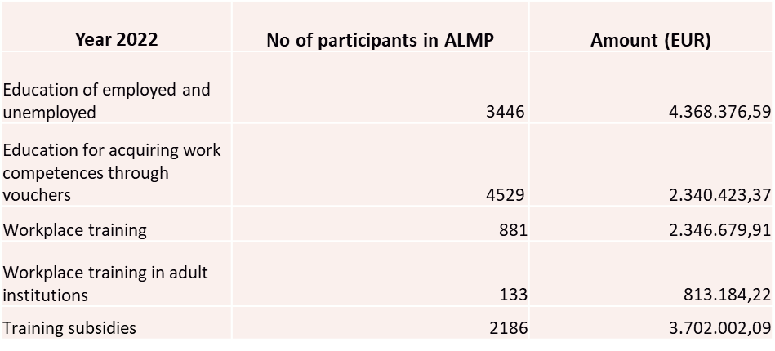

Education
Active labour market policy measures
The Croatian Employment Service programme of Active Labour Market Policy for 2023 includes the following education and training measures:
education of the unemployed and employed,
education for acquiring work competences through vouchers
workplace training,
workplace training in adult training institutions
training subsidies
Activation programme Job+ (education for acquiring core skills and professional development)
Source of funding: ESF +, National Recovery and Resilience Plan 2021-2026, State Budget
www.mjere.hr

Slide 8
JOB +
Reforms currently implemented through National Recovery and Resilience Plan in relation to unemployed persons and vulnerable groups:
Strengthening human capacities and improving skills for working with vulnerable groups
Improving the profiling system and segmentation of vulnerable groups
Establishment of the integration plan and activation programs of vulnerable groups in the labor market
Expansion and reorganization of the existing network of CISOK centers with a focus on their role in attracting NEETs
Designed for vulnerable groups
work and social integration into the labor market
3 components –
1) activation and readiness for acceptance of changes implemented through the Activation Program
2) work integration through public work or training in the real workplace
3) education component implemented through education measures - education for professional skills

Slide 9
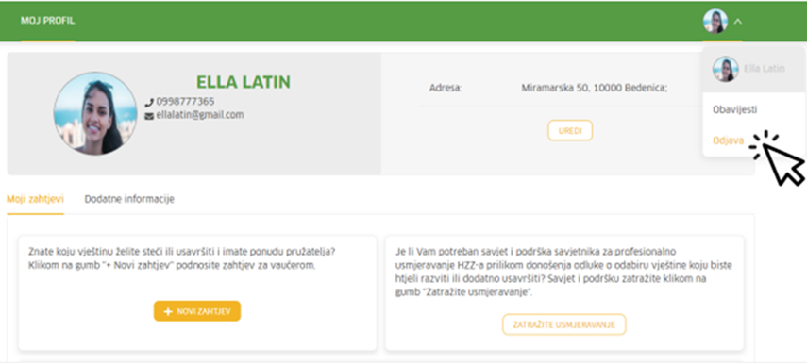

Voucher- Based Adult Education Scheme
The project is financed through the National Recovery and Resilience Plan (300 million HRK ~ 39.9 million €) and is in force since 1st April 2022 (till 2026)
Aim:
to increase the rate of participation in adult education in Croatia (5.1 % in HR; 10.8% in the EU; 2021 data)
to promote the acquisition of digital and green skills, to foster better coping with technological, social and economic changes and improve long-term competitiveness and productivity of the workforce and Croatian economy
Targets:
30.000 users (unemployed and employed)
40% from vulnerable groups (LTU, NEET, inactive)
70% green : 30% digital
Current numbers:
over 14.000 granted vouchers
732 (97 different) programmes; 130 education providers
8.6 million EUR of disbursements
Voucher - a financial instrument of allocation of public funds for adult learning. It promotes flexible and tailor-made way for acquiring micro and partial digital and green and other deficit qualifications. Eligible programmes must be formal and in accordance with CROQF (Croatian Qualifications Framework)
Users independently choose the programme and the education provider from the available programmes and skills catalogue. The application is submitted through online platform mojvaucer.hzz.hr

Slide 10
Hrvatski zavod za zapošljavanje
Croatian Employment Service
Savska cesta 64
10000 Zagreb
+385 1 6126 000
+385 1 6126 038
hzz@hzz.hr www.hzz.hr
Thank you for your attention!

